Slide 1

Parser AST Generation
Muhammad Mujtaba Afzal 14882

Slide 2
Create Node Classes
A root/parent Node class.
Node classes for all rules.
An abstract class for non-terminals having multiple rules.
Program -> statements
statements -> statement statements
statements -> statement statement -> assignStmt statement -> ifStmt statement -> whileStmt assignStmt -> id = expr ifStmt -> if ( cmpr ) statement whileStmt -> while ( cmpr ) statement expr -> id expr -> int expr -> term OP expr cmpr -> term == expr term -> id
id -> ^[a-zA-Z_][a-zA-Z0-9_]*$
int -> [0-9]+
OP -> [+|-|*|/]

Slide 3
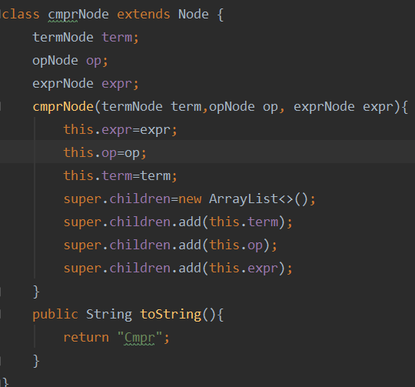
Inside a Class
Declare child Nodes.
Make child nodes.
Array to store children.
toString() to print ast node.

Slide 4
Token Class for Stack/Reduction
Stack can have 3 types of elements.
For push() we create respective object an push.
Save popped tokens in array.
Array is used to create AST nodes.
class TokenClass{ String type; int state; Node node; Token token; String name; TokenClass(int state){ this.state=state; this.type="state"; } TokenClass(Node node, String name){ this.node=node; this.type="node"; this.name=name; } TokenClass(Token node){ this.token=node; this.type="token"; } }

Slide 5
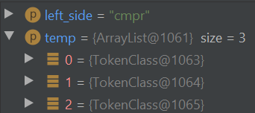
AST Creation
Fired at reduction.
Use the popped tokens from stack (stored in array).
Use the rule name (left side).
Check left_side and create the required node.
cmprNode(termNode term,opNode op, exprNode expr)

Slide 6
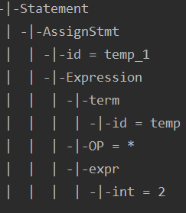
Print Ast
Use children array in each class.
Traverse the children array.
Algorithm used: Pretty Print Tree in Python · Vallentin
Example: temp_1 = temp * 2

